Slide 1
Internet and Web Programming Course Code: CSE4001
Unit 1
Dr. Amrendra Singh Yadav
Assistant Professor
Computer Science and Engineering,
VIT, Bhopal

Slide 2
Internet Overview- WWW
The Internet is essentially a global network of computing resources. You can think of the Internet as a physical collection of routers and circuits as a set of shared resources.
It uses standard internet protocol suite (TCP/IP) to connect billions of computer users worldwide.
It is set up by using cables such as optical fibers and other wireless and networking technologies.
At present, internet is the fastest mean of sending or exchanging information and data between computers across the world.

Slide 3
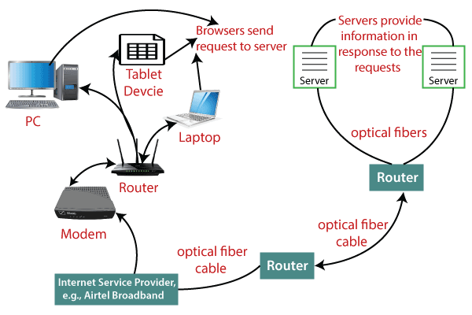
Cont’d…

Slide 4
Internet basics
The Internet and the WWW (World Wide Web) are not the same.
The WWW is explored using a browser and the act of browsing the Internet is commonly referred to as surfing.
Users browse websites and web pages by following hyperlinks that point to an address more commonly referred to as a URL.
Finding information on the Internet is achieved using a search engine.
Files, pictures, songs, and video can be shared by downloading (receiving) and uploading (sending).
The Internet utilizes the TCP/IP protocol and is accessed using a dial-up modem, broadband, 3G, 4G, or network connected through an ISP.
With broadband, many computers and devices use Wi-Fi to connect to a router and share an Internet connection.
The computer you're using to view this web page is considered a host and it's connected to our server to view this page.

Slide 5
Internet services
In addition to browsing the Internet with a browser, the Internet has the following other services.
Chat
E-mail
Forum
FTP
Online gaming
Social network
VoIP

Slide 6
Why do people use the Internet?
Today, the Internet is the best place to communicate and share information with people from anywhere on the glove.
It also supplies an endless supply of knowledge and entertainment.
Why is the Internet considered a network?
The Internet is the world's largest network because it's a collection of computers and servers that are connected to each other globally using routers and switches.
The Internet works the same way a network would in a home or office but has millions of more computers, routers, and switches.

Slide 7
Advantages of the Internet
Instant Messaging: You can send messages or communicate to anyone using internet, such as email, voice chat, video conferencing, etc.
Get directions: Using GPS technology, you can get directions to almost every place in a city, country, etc. You can find restaurants, malls, or any other service near your location.
Online Shopping: It allows you to shop online such as you can be clothes, shoes, book movie tickets, railway tickets, flight tickets, and more.
Pay Bills: You can pay your bills online, such as electricity bills, gas bills, college fees, etc.
Online Banking: It allows you to use internet banking in which you can check your balance, receive or transfer money, get a statement, request cheque-book, etc.
Online Selling: You can sell your products or services online. It helps you reach more customers and thus increases your sales and profit.
Work from Home: In case you need to work from home, you can do it using a system with internet access. Today, many companies allow their employees to work from home.
Entertainment: You can listen to online music, watch videos or movies, play online games.
Cloud computing: It enables you to connect your computers and internet-enabled devices to cloud services such as cloud storage, cloud computing, etc.

Slide 8
Internet protocols
The way that someone who wants to use a service talks with that service
Internet protocols consist of a suite of communication protocols
Transmission Control Protocol (TCP)
Internet Protocol (IP)
Also specifies common applications such as electronic mail, terminal emulation, and file transfer

Slide 9
TCP/IP
First developed in the mid-1970s, by Defense Advanced Research Projects Agency (DARPA)
establishing a packet-switched network that would facilitate communication between dissimilar computer systems at research institutions
The foundation on which the Internet and the World Wide Web (WWW) are based.

Slide 10
TCP/IP
Provides reliable transmission of data in an IP environment.
Services TCP provides
Stream data transfer
TCP delivers an unstructured stream of bytes identified by sequence numbers
TCP groups bytes into segments and passes them to IP for delivery.
Reliability
Providing connection-oriented, end-to-end reliable packet delivery

Slide 11
TCP/IP
Efficient flow control
When sending acknowledgments back to the source, the receiving TCP process indicates the highest sequence number it can receive without overflowing its internal buffers
Full-duplex operation
TCP processes can both send and receive at the same time
Multiplexing
Simultaneous upper-layer conversations can be multiplexed over a single connection

Slide 12
TCP/IP
Efficient flow control
When sending acknowledgments back to the source, the receiving TCP process indicates the highest sequence number it can receive without overflowing its internal buffers
Full-duplex operation
TCP processes can both send and receive at the same time
Multiplexing
Simultaneous upper-layer conversations can be multiplexed over a single connection

Slide 13
Cont’d…
SMTP(Simple Mail Transfer Protocol): These protocols are important for sending and distributing outgoing emails. This protocol uses the header of the mail to get the email id of the receiver and enters the mail into the queue of outgoing mails. And as soon as, it delivers the mail to the receiving email id, it removes the email from the outgoing list.
PPP(Point to Point Protocol): It is a communication protocol that is used to create a direct connection between two communicating devices. This protocol defines the rules using which two devices will authenticate with each other and exchange information with each other. For example, A user connects his PC to the server of an Internet Service Provider also uses PPP. Similarly, for connecting two routers for direct communication it uses PPP.

Slide 14
Cont’d…
FTP (File Transfer Protocol): This protocol is used for transferring files from one system to the other. This works on a client-server model. When a machine requests for file transfer from another machine, the FTO sets up a connection between the two and authenticates each other using their ID and Password. And, the desired file transfer takes place between the machines.
SFTP(Secure File Transfer Protocol): SFTP which is also known as SSH FTP refers to File Transfer Protocol (FTP) over Secure Shell (SSH) as it encrypts both commands and data while in transmission. SFTP acts as an extension to SSH and encrypts files and data then sends them over a secure shell data stream. This protocol is used to remotely connect to other systems while executing commands from the command line.

Slide 15
Cont’d…
TELNET(Terminal Network): TELNET is a standard TCP/IP protocol used for virtual terminal service given by ISO. This enables one local machine to connect with another. The computer which is being connected is called a remote computer and which is connecting is called the local computer. TELNET operation lets us display anything being performed on the remote computer in the local computer.
POP3(Post Office Protocol 3): POP3 stands for Post Office Protocol version 3. It has two Message Access Agents (MAAs) where one is client MAA (Message Access Agent) and another is server MAA(Message Access Agent) for accessing the messages from the mailbox. This protocol helps us to retrieve and manage emails from the mailbox on the receiver mail server to the receiver’s computer. This is implied between the receiver and receiver mail server.

Slide 16
Introduction to World Wide Web
The World Wide Web (WWW) is a collection of documents and other web resources which are identified by URLs, interlinked by hypertext links, and can be accessed and searched by browsers via the Internet.
World Wide Web is also called the Web and it was invented by Tim Berners-Lee in 1989.
Website is a collection of web pages belonging to a particular organization.
The pages can be retrieved and viewed by using browser.

Slide 17
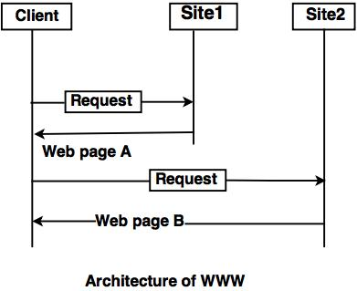
Cont’d…
Let us go through the scenario shown in fig.
The client wants to see some information that belongs to site 1.
It sends a request through its browser to the server at site 2.
The server at site 1 finds the document and sends it to the client.

Slide 18
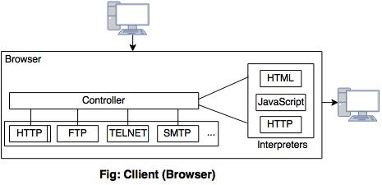
Client (Browser)
Web browser is a program, which is used to communicate with web server on the Internet.
Each browser consists of three parts: a controller, client protocol and interpreter.
The controller receives input from input device and use the programs to access the documents.
After accessing the document, the controller uses one of the interpreters to display the document on the screen.

Slide 19
Server
A computer which is available for the network resources and provides service to the other computer on request is known as server.
The web pages are stored at the server.
Server accepts a TCP connection from a client browser.
It gets the name of the file required.
Server gets the stored file. Returns the file to the client and releases the top connection.

Slide 20
Uniform Resource Locater (URL)
The URL is a standard for specifying any kind of information on the Internet.
The URL consists of four parts: protocol, host computer, port and path.
The protocol is the client or server program which is used to retrieve the document or file. The protocol can be ftp or http.
The host is the name of computer on which the information is located.
The URL can optionally contain the port number and it is separated from the host name by a colon.
Path is the pathname of the file where the file is stored.

Slide 21
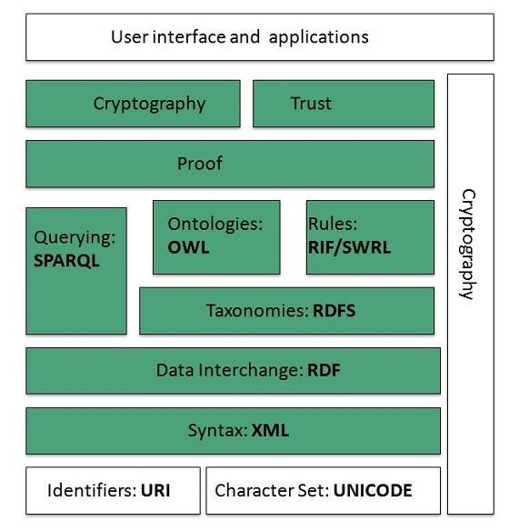
WWW Architecture

Slide 22
Cont’d…
Identifiers and Character Set
Uniform Resource Identifier (URI) is used to uniquely identify resources on the web and UNICODE makes it possible to built web pages that can be read and write in human languages.
Syntax
XML (Extensible Markup Language) helps to define common syntax in semantic web.
Data Interchange
Resource Description Framework (RDF) framework helps in defining core representation of data for web. RDF represents data about resource in graph form.

Slide 23
What is the URL
A URL is a type of uniform resource identifier and is address of a resource on the World Wide Web and the protocol used to access it. It is used to indicate the location of a web resource to access the web pages.
For example, to visit the java point website, you will go to the URL www.javatpoint.com, which is the URL for the java point website.
The URL sends users to a specific resource online such as video, webpage, or other resources. When you search any query on Google, it will display the multiple URLs of the resource that are all related to your search query.
The displayed URLs are the hyperlink to access the webpages.

Slide 24
Cont’d…
A URL (Uniform Resource Locator) contains the information, which is as follows:
The port number on the server, which is optional.
It contains a protocol that is used to access the resource.
The location of the server
A fragment identifier
In the directory structure of the server, it contains the location of the resource.

Slide 25
Domain Name
A domain name is the part of your Internet address that comes after "www". For example, in Tutorialspoint.com the domain name is tutorialspoint.com.
A domain name becomes your Business Address so care should be taken to select a domain name. Your domain name should be easy to remember and easy to type.

Slide 26
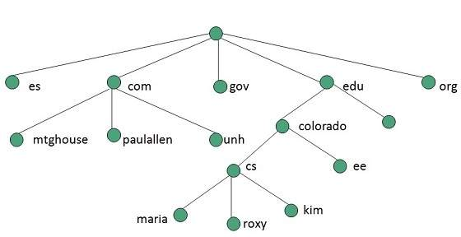
Cont’d…
The domain name space refers a hierarchy in the internet naming structure.
This hierarchy has multiple levels (from 0 to 127), with a root at the top.
The following diagram shows the domain name space hierarchy:

Slide 27
Domain Extension Types
There are many types of domain extensions you can choose for your domain name. This depends on your business nature.
For example, if you are going to register a domain name for education purpose then you can choose .edu extension.
.com − Stands for company/commercial, but it can be used for any website.
.net − Stands for network and is usually used for a network of sites.
.org − Stands for organization and is supposed to be for non-profit bodies.
.us, .in − They are based on your country names so that you can go for country specific domain extensions
.biz − A newer extension on the Internet and can be used to indicate that this site is purely related to business.
.info − Stands for information. This domain name extension can be very useful, and as a new comer it's doing well.
.tv − Stands for Television and are more appropriate for TV channel sites.

